Slide 1






DEEP LEARNING IMPLIMENTATION
IMAGE CLASSIFICATION BASED ON TYPES
By Vishruth S M
Supervisor: Professor Shagufta Henna

Slide 2
INTRODUCTION AND DATASET
This project leverages Convolutional Neural Networks to classify images into complex categories like Animals, Portraits, Landscapes, and Psychedelics, enhancing digital content sorting.
The dataset includes a diverse array of these categories, processed and augmented to challenge the model with real-world variability.
An 80/20 training/validation split ensures robust learning while preventing overfitting, setting the stage for reliable image recognition.

Slide 3

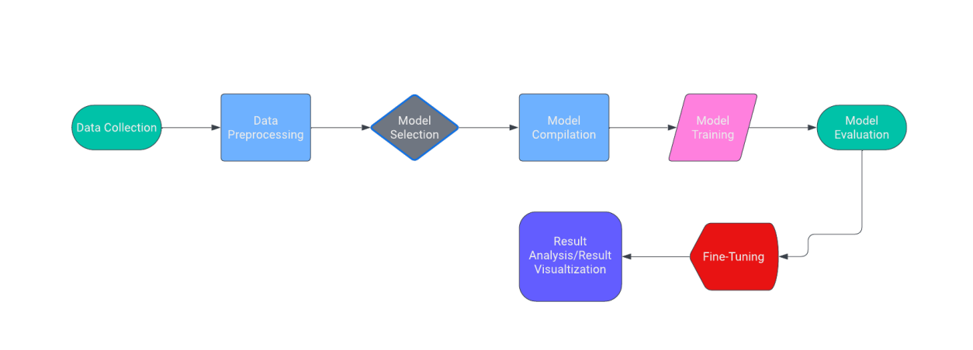


TECHNICAL ARCHITECTURE

Slide 4



MODEL ARCHITECTURE AND TRAINING
THE CNN MODEL EMPLOYS SEQUENTIAL LAYERS, THREE CONVOLUTIONAL LAYERS WITH MAX-POOLING, AND A 50% DROPOUT TO PREVENT OVERFITTING.
A DENSE LAYER OF 512 NEURONS LEADS TO A SOFTMAX OUTPUT, CLASSIFYING IMAGES INTO FOUR CATEGORIES: ANIMALS, PORTRAITS, LANDSCAPES, AND PSYCHEDELICS.
ADAM OPTIMIZER AND CATEGORICAL CROSSENTROPY ARE USED FOR EFFICIENT LEARNING ACROSS 19,035,716 TRAINABLE PARAMETERS.
TRAINING SPANS 20 EPOCHS, WITH ACCURACY AND LOSS METRICS GUIDING PERFORMANCE EVALUATIONS AGAINST A 20% VALIDATION SET.
THIS STRUCTURED APPROACH ENSURES THE MODEL CAPTURES COMPLEX IMAGE FEATURES AND GENERALIZES WELL TO NEW DATA.

Slide 5
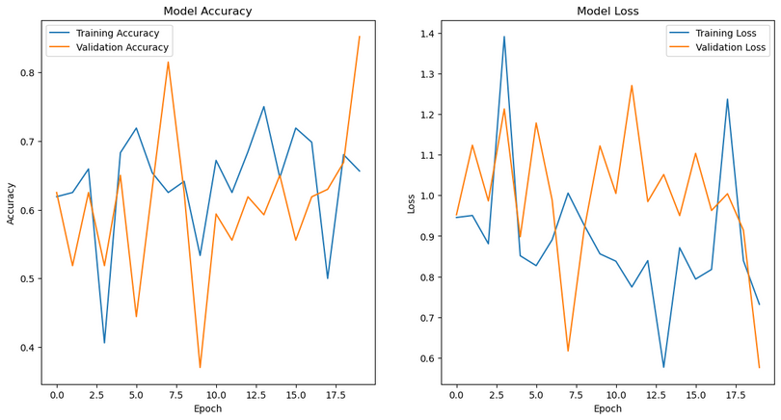
TRAINING RESULTS
BEGAN WITH A 33.04% ACCURACY, THE MODEL IMPROVED SIGNIFICANTLY OVER 20 EPOCHS, REFLECTING PATTERN RECOGNITION FROM THE BASELINE.
NOTABLE MILESTONES INCLUDE ACHIEVING A 62.50% TRAINING ACCURACY BY THE SIXTH EPOCH AND A PEAK VALIDATION ACCURACY OF 77.78%.
FINAL EPOCH RESULTS SHOWED A TRAINING ACCURACY OF 65.62%, WITH VALIDATION ACCURACY AT 40.74%, INDICATING AREAS FOR OPTIMIZATION TO COMBAT OVERFITTING.

Slide 6
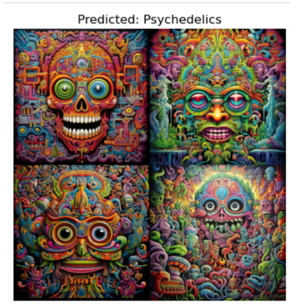
ANALYSIS AND IMAGE PREDICTION
ANALYSIS: ARCHITECTURAL DECISIONS, LIKE FILTER QUANTITY AND DROPOUT RATE, WERE PIVOTAL FOR ENHANCING ACCURACY AND MINIMIZING OVERFITTING.
IMAGE PREDICTION: A TEST ON AN UNSEEN 'PSYCHEDELICS' IMAGE SHOWED THE MODEL'S EFFICACY, WITH A 98.64% CONFIDENCE IN CORRECT CLASSIFICATION.
VISUALIZATION: DISPLAY OF THE PREDICTED IMAGE VERIFIED THE MODEL'S PREDICTIVE STRENGTH AND ITS ABILITY TO GENERALIZE FROM TRAINING TO NEW DATA.

Slide 7
CONCLUSION
The project's CNN model excelled in classifying complex image categories, with marked success in the intricate 'Psychedelics' category, highlighting the strength of our tailored architecture and training approach.
Data augmentation played a pivotal role in equipping the model to handle real-world image variations, boosting its robustness and reducing overfitting.
While achieving high accuracy, the model's fluctuations in validation suggest further fine-tuning, and a larger dataset could refine its capability for nuanced distinctions.
Overall, this study underscores CNNs' potential in image classification and sets a foundation for future enhancements in deep learning-based image analysis.

Slide 8

THANK YOU!

